Slide 1
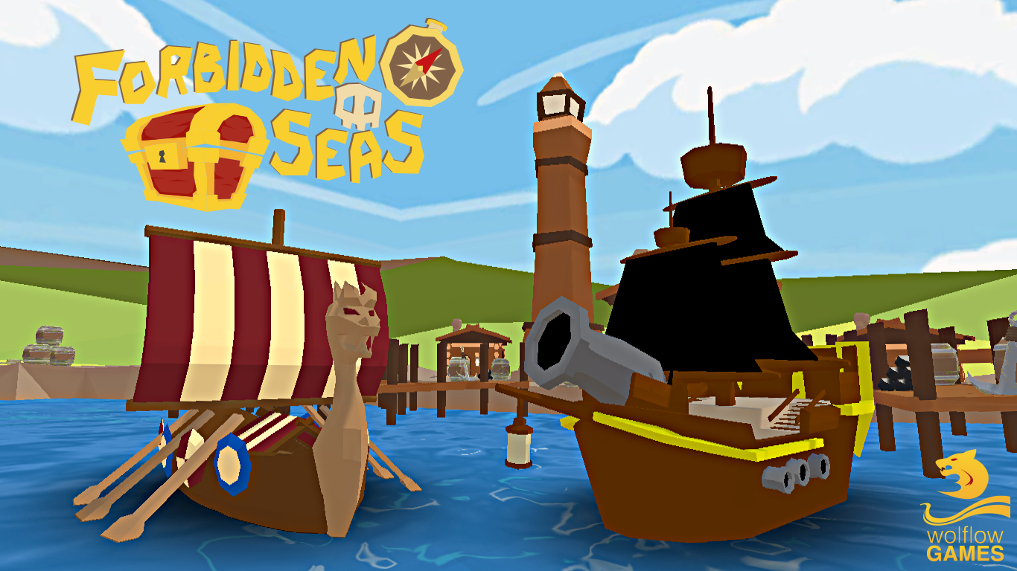

Slide 2

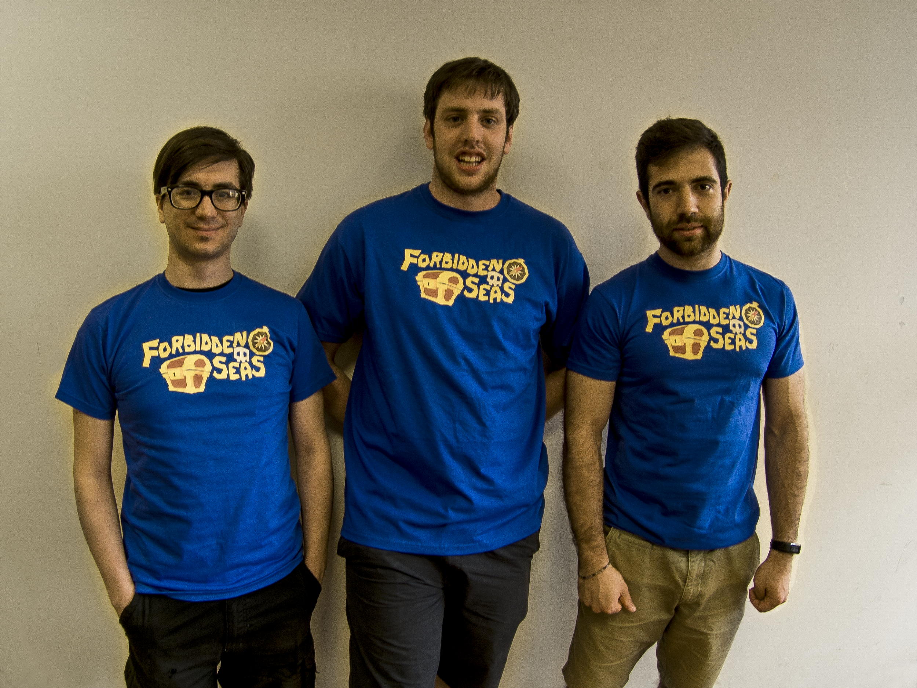

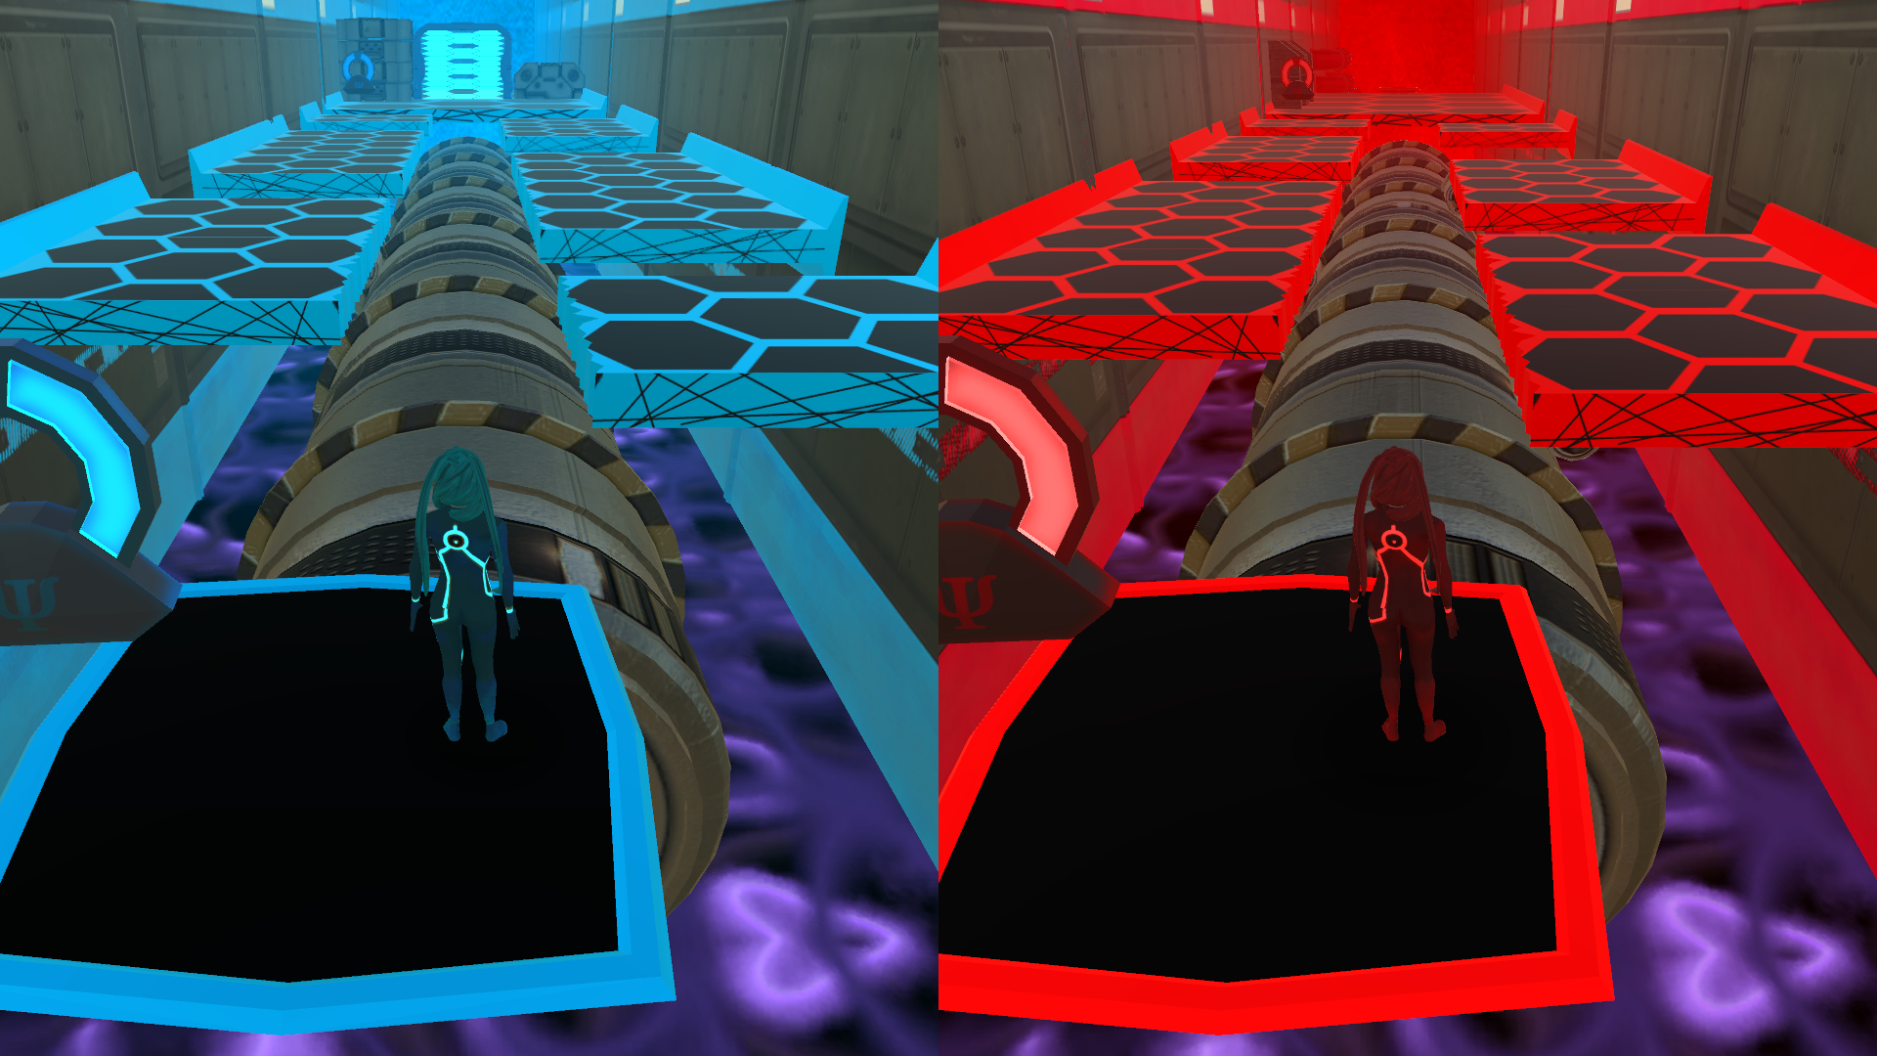
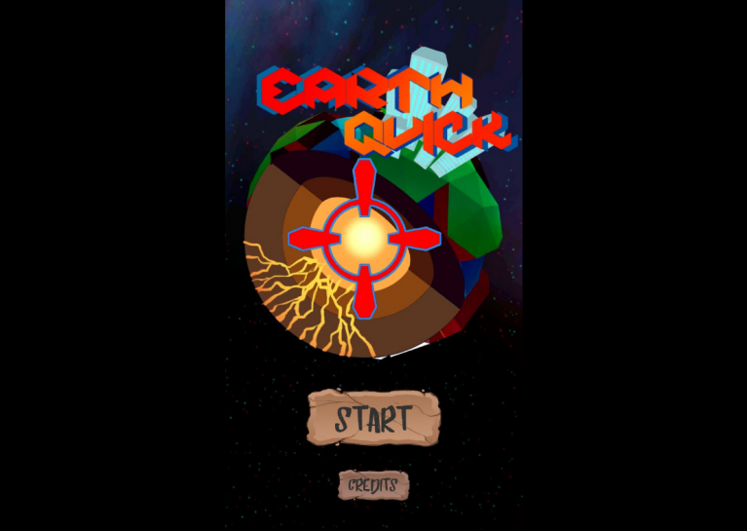
Development Team
wolflow games was born in 2016, founded by Matteo Marras, Alberto Ronchetti and Manuel Salvadori, based in Milan.
Entanglement - PC
EarthQuick - Android

Slide 3
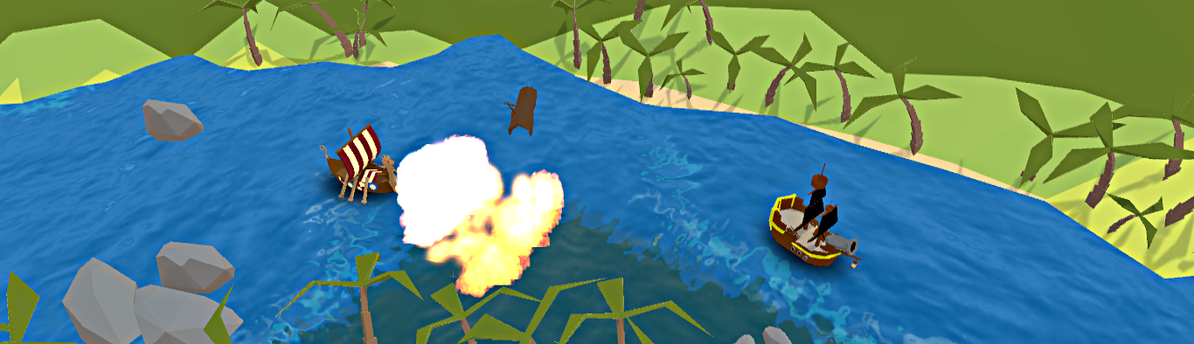
Project ID
“Overwatch meets Mario Kart in a toon piratical setting”
Working Title: Forbidden Seas
Genre: MOBA + Kart Racing Format: PC Scope: digital only Target audience: casual players
N. Players: 4-8
Engine: Unity

Slide 4

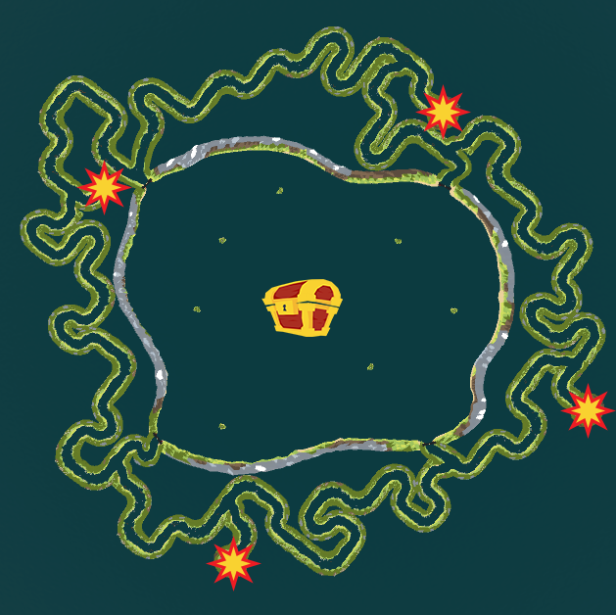

Gameplay
Map
Capture the flag
Time attack
Master mode
2 vs 2
4 vs 4

Slide 5





Innovative input system (scroll wheel)
Unique environment
Mashup between MOBA games and kart games
Buddies
Unique Selling Points

Slide 6
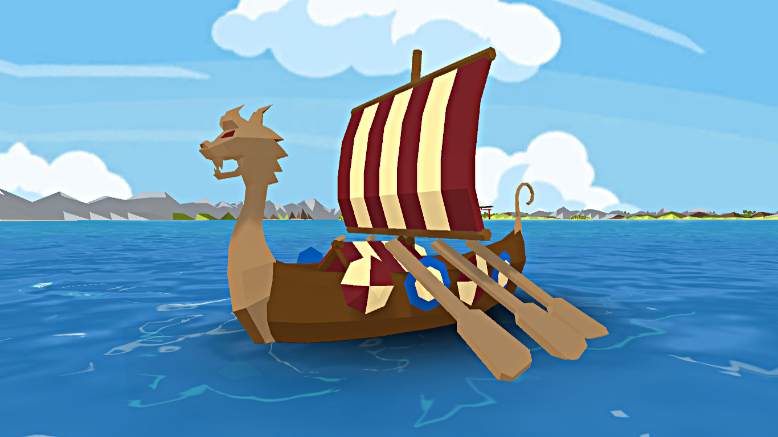




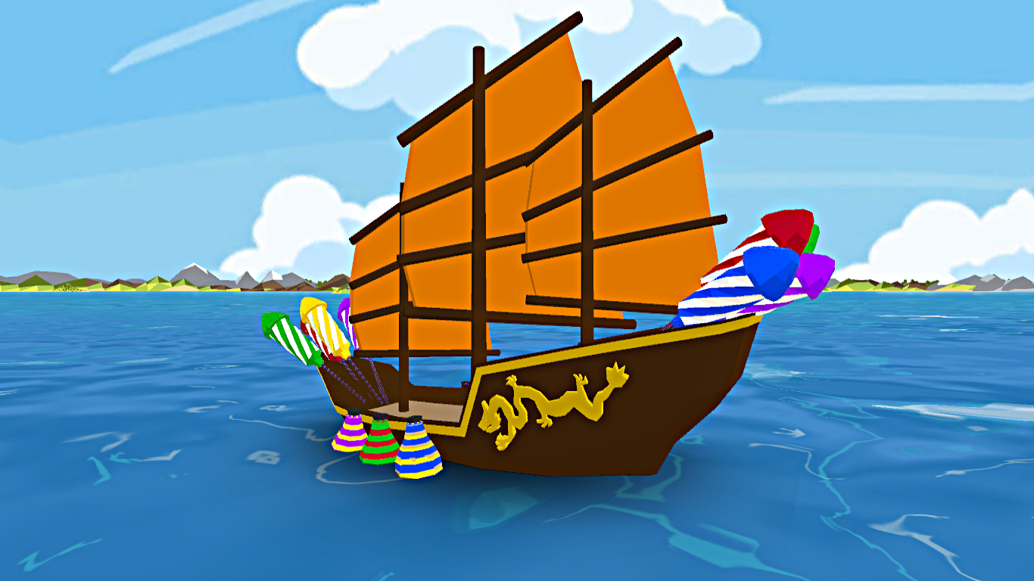
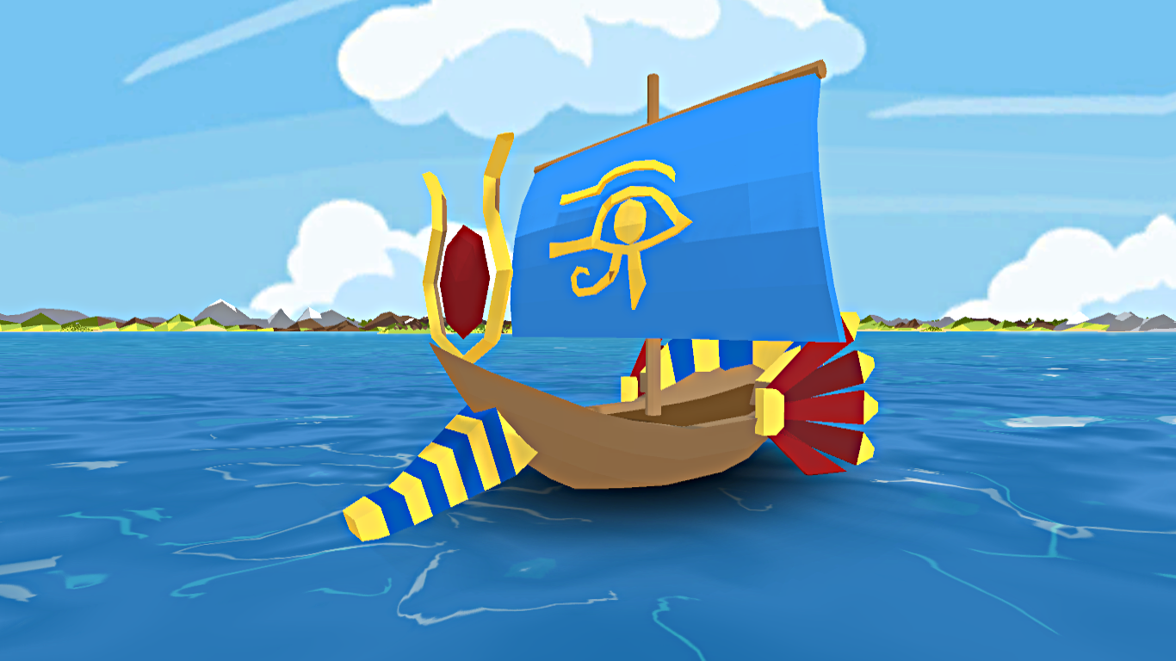

Replay Value & Extensibility
A lot of ships to choose from
Each one has its own attacks and stats

Slide 7


Budget and Schedule
1 April 2019
Final Release
Nov 2018
Open Beta
29 June 2017
Prototype
850k €
Total
Sept 2018
Closed Beta
2 years of
development

Slide 8

Budget and Schedule
Total
850k €
1 April 2019
Final Release
Nov 2018
Open Beta
29 June 2017
Prototype
90%
Salaries
Sept 2018
Closed Beta
2 years of
development

Slide 9
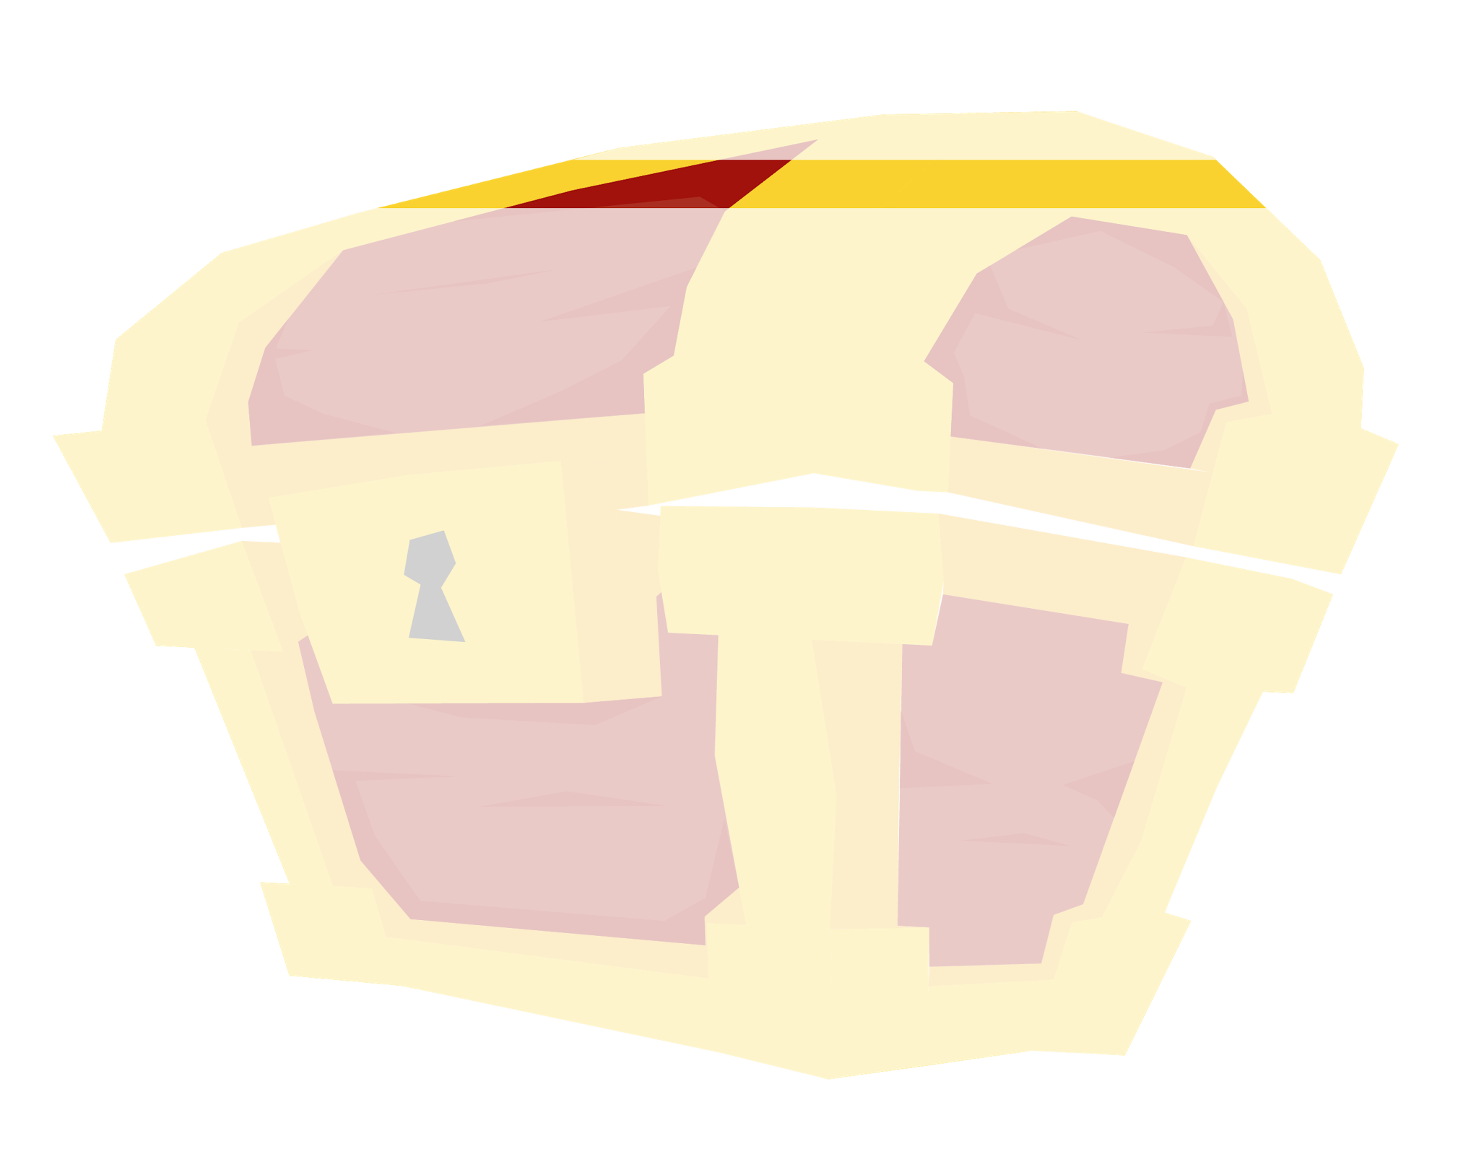
Budget and Schedule
Total
850k €
1 April 2019
Final Release
Nov 2018
Open Beta
29 June 2017
Prototype
5%
Hardware
Sept 2018
Closed Beta
2 years of
development

Slide 10
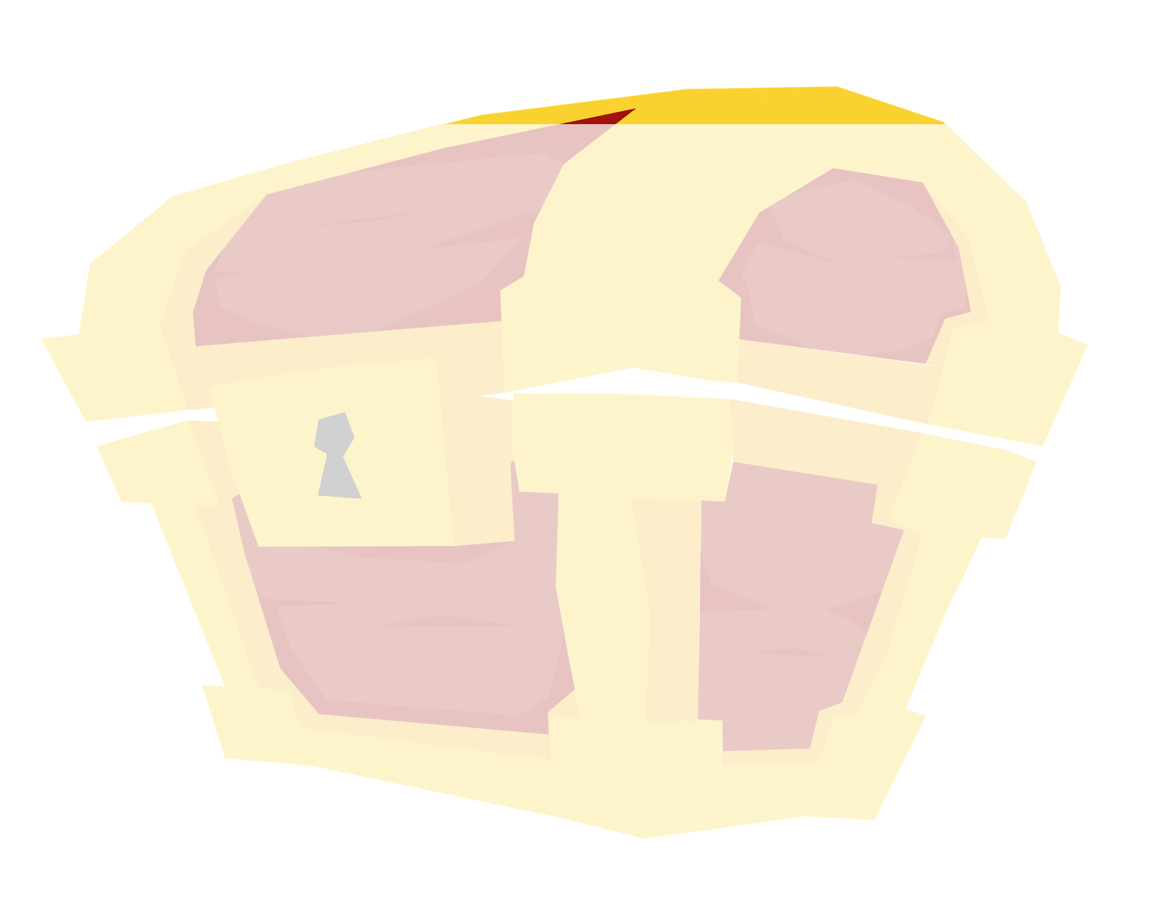
Budget and Schedule
Total
850k €
1 April 2019
Final Release
Nov 2018
Open Beta
29 June 2017
Prototype
5%
Software
Sept 2018
Closed Beta
2 years of
development

Slide 11
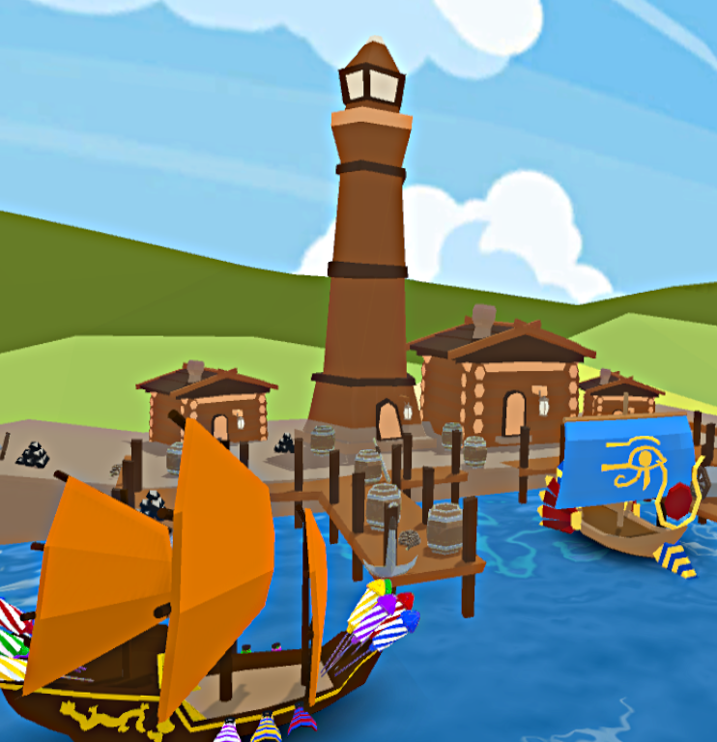
Executive Summary
MOBA + Kart game
Capture the flag mode
A lot of ships
Skins, DLC system and additions
Total budget 850k €
Release window Q2 2019
Breakeven estimation ~ 1 year

Slide 12

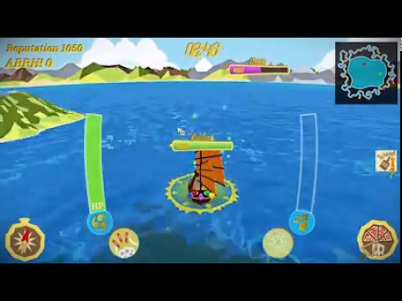

wolflow games
Milan
/forbiddenseasthegame
Matteo Marras
Alberto Ronchetti
Manuel Salvadori

